Slide 1
Introduction Virtualization Definition – Virtual Machine Basics – Benefits – Need For Virtualization – Limitations − Traditional Vs. Contemporary Virtualization Process – Virtual Machines – Taxonomy – Challenges
CSE4011-
MODULE 1
VIRTUALIZATION

Slide 2
Introduction
Virtualization
Virtualization refers to the creation of a virtual resource such as a server, desktop, operating system, file, storage or network.
Goal -to manage workloads by radically transforming traditional computing to make it more scalable.
Virtualization has been a part of the IT landscape for decades now, and today it can be applied to a wide range of system layers, including
Operating system-level virtualization,
Hardware-level virtualization and
Server virtualization.

Slide 3
Virtual Machine
The most common form of virtualization is the operating system-level virtualization.
In this , it is possible to run multiple operating systems on a single piece of hardware.
Virtualization technology involves separating the physical hardware and software by emulating hardware using software.
When a different OS is operating on top of the primary OS by means of virtualization, it is referred to as a virtual machine.

Slide 4
Virtual Machine
Virtual machine -data file on a physical computer that can be moved and copied to another computer, just like a normal data file.
The computers in the virtual environment use two types of file structures:
One defining the hardware and the other defining the hard drive.
The virtualization software, or the hypervisor, offers caching technology that can be used to cache changes to the virtual hardware or the virtual hard disk for writing at a later time.

Slide 5
Virtualization- Benefits
Speedy Recovery Time:
System failure or disaster- virtualization allows for faster recovery of IT resources which provides for improved business continuity and revenue.
Older infrastructures are incapable of recovering within a few hours and in most cases, companies experience a much longer downtime which results in revenue loss.
Better Scalability:
Virtualized environments are designed to be scalable which allows for more flexibility when it comes to company growth.
Instead of purchasing additional infrastructure components, new applications and upgrades can easily be implemented with virtualization.

Slide 6
Virtualization- Benefits (Contd...)
Cost and Space Savings:
Saving on the costs of IT infrastructure is a reality when you switch to virtualization.
Better Return on Investment:
In addition to reducing the costs of maintaining an older infrastructure, companies can increase their ROI by ensuring business continuity following a disaster and preventing revenue loss.
These are the basic benefits which can be gained by switching to virtualization.
There are additional benefits which will depend upon the type of infrastructure which is necessary for a specific industry.

Slide 7
Need for virtualization
Enhanced Performance
Limited use of Hardware and Software Resources
Need for virtualization
Shortage of Space
Eco-friendly Initiatives
Administrative Costs

Slide 8
Need for virtualization
Enhanced Performance Most of the end user systems have sufficient resources which can host a virtual machine manager and can perform a virtual machine with acceptable performance so far.
Limited use of Hardware and Software Resources
Efficiency of IT infrastructure could be increase by using the resources after hours for other purposes. This environment is possible to attain with the help of Virtualization.
Shortage of Space
Mostly, enterprises unable to pay to build any other data center to accommodate additional resource capacity. This heads to the diffusion of a technique which is known as server consolidation.

Slide 9
Need for virtualization
Eco-friendly Initiatives
Server consolidation drops the power consumed and cooling impact by having a fall in number of servers. Virtualization can provide a sophisticated method of server consolidation.
Administrative Costs
The administrative costs is increased as per the number of servers. Virtualization decreases number of required servers for a given workload, hence reduces the cost of administrative employees.

Slide 10
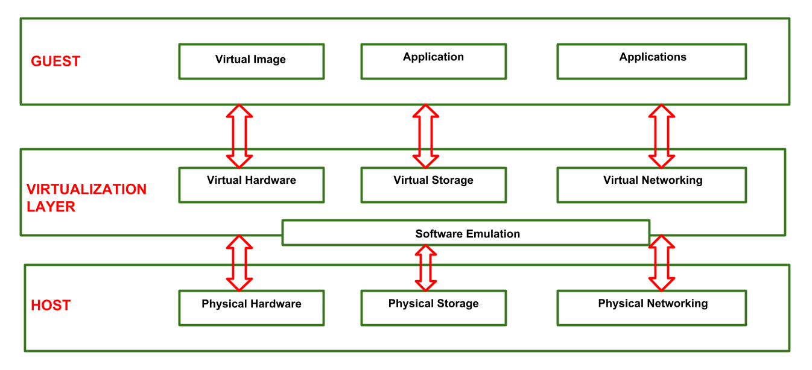
Virtualization Reference Model

Slide 11
Virtualization Reference Model
Three major Components falls under this category in a virtualized environment:
1. Guest:
System component that interacts with the virtualization layer
Guests usually consist of one or more virtual disk files, and a VM definition file.
2. Host:
Original environment where the guest is supposed to be managed.
Each guest runs on the host using shared resources donated to it by the host.
3. Virtualization Layer:
Responsible for recreating the same or a different environment where the guest will operate.
It is an additional abstraction layer between a network and storage hardware, computing, and the application running on it.

Slide 12
Virtualization-Limitations
Upfront costs.
The investment in the virtualization software, and possibly additional hardware might be required to make the virtualization possible.
This depends on your existing network.
Many businesses have sufficient capacity to accommodate the virtualization without requiring a lot of cash.
This obstacle can also be more readily navigated by working with a Managed IT Services provider, who can offset this cost with monthly leasing or purchase plans.

Slide 13
Virtualization-Limitations
Software licensing considerations.
This is becoming less of a problem as more software vendors adapt to the increased adoption of virtualization, but it is important to check with your vendors to clearly understand how they view software use in a virtualized environment
Possible learning curve.
Implementing and managing a virtualized environment will require IT staff with expertise in virtualization.
On the user side a typical virtual environment will operate similarly to the non-virtual environment.
There are some applications that do not adapt well to the virtualized environment – this is something that your IT staff will need to be aware of and address prior to converting.

Slide 14
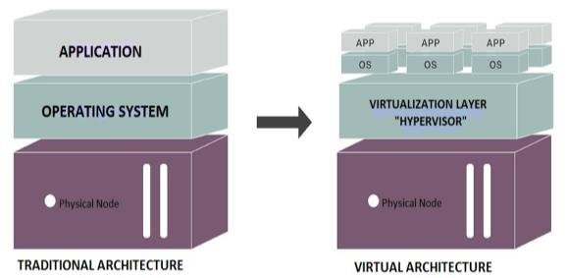
Traditional Vs. Contemporary Virtualization Process

Slide 15
Traditional Vs. Contemporary Virtualization Process
VIRTUALIZATION | CLOUD COMPUTING
Technology that allows you to create multiple simulated environments or dedicated resources from a single, physical hardware system. Software called a hypervisor connects directly to that hardware and allows you to split 1 system into separate, distinct, and secure environments known as virtual machines (VMs). These VMs rely on the hypervisor’s ability to separate the machine’s resources from the hardware and distribute them appropriately. | Set of principles and approaches to deliver compute, network, and storage infrastructure resources, services, platforms, and applications to users on-demand across any network. These infrastructure resources, services, and applications are sourced from clouds, which are pools of virtual resources orchestrated by management and automation software so they can be accessed by users on-demand through self-service portals supported by automatic scaling and dynamic resource allocation.

Slide 16
Traditional Vs. Contemporary Virtualization Process
 | Virtualization | Cloud
Definition | Technology | Methodology
Purpose | Create multiple simulated environments from 1 physical hardware system | Pool and automate virtual resources for on-demand use
Use | Deliver packaged resources to specific users for a specific purpose | Deliver variable resources to groups of users for a variety of purposes
Configuration | Image-based | Template-based
Lifespan | Years (long-term) | Hours to months (short-term)
Cost | High capital expenditures (CAPEX), low operating expenses (OPEX) | Private cloud: High CAPEX, low OPEX Public cloud: Low CAPEX, high OPEX
Scalability | Scale up | Scale out
Workload | Stateful | Stateless
Tenancy | Single tenant | Multiple tenants

Slide 17
Virtual Machines
Virtual machines are becoming more common with the evolution of virtualization technology.
Virtual machines are often created to perform certain tasks that are different than tasks performed in a host environment.
Virtual machines are implemented by software emulation methods or hardware virtualization techniques.
Depending on their use and level of correspondence to any physical computer, virtual machines can be divided into two categories: System Virtual Machines and Process Virtual Machine

Slide 18
Virtual Machines
System Virtual Machines:
A system platform that supports the sharing of the host computer's physical resources between multiple virtual machines, each running with its own copy of the operating system.
The virtualization technique is provided by a software layer known as a hypervisor, which can run either on bare hardware or on top of an operating system.
Process Virtual Machine:
Designed to provide a platform-independent programming environment that masks the information of the underlying hardware or operating system and allows program execution to take place in the same way on any given platform.

Slide 19
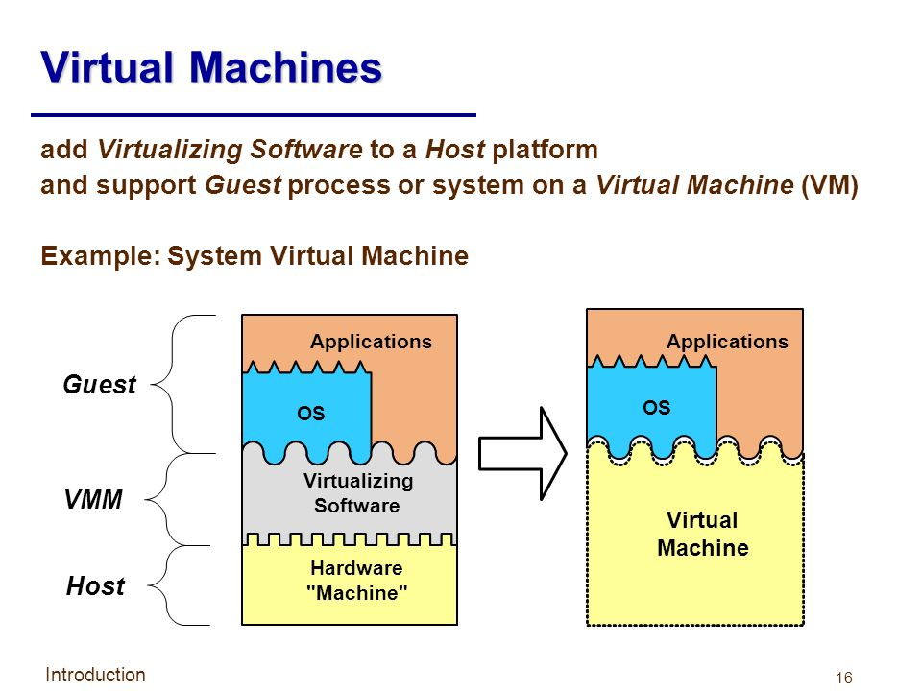
System VMs

Slide 20
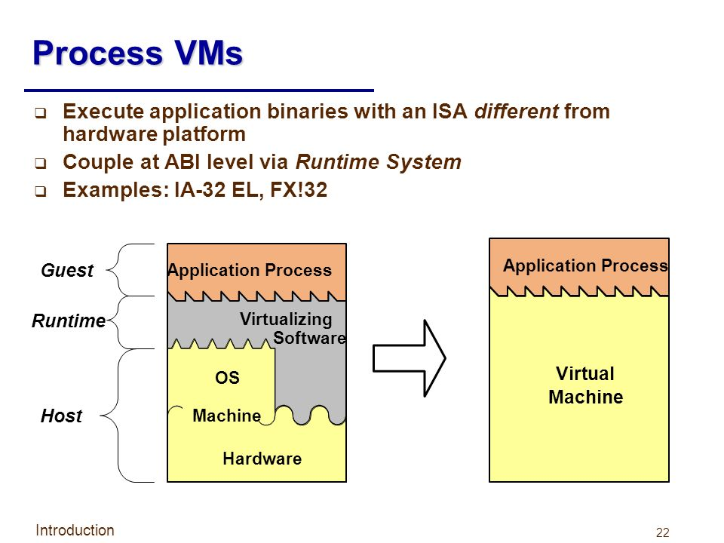

Slide 21
Virtual Machines- Advantages
Allows multiple operating system environments on a single physical computer without any intervention
Virtual machines are widely available and are easy to manage and maintain.
Offers application provisioning and disaster recovery options

Slide 22
Virtual Machines- Drawbacks
They are not as efficient as a physical computer because the hardware resources are distributed in an indirect way.
Multiple VMs running on a single physical machine can deliver unstable performance

Slide 23
Benefits of Virtual Machine Hosting
Familiar Interfaces – Virtual environments are built to mimic physical ones, so you should never have any idea that you’re running on a virtual machine.
High Availability –If one server fails, another virtual machine can be spun up with minimal downtime or data loss.
Scalability – Virtualized machines allow scalability on demand without adding physical resources, and they can be expanded much easier than in a physical machine. Adding additional RAM to a virtual machine can be done in a few minutes, while it can be up to a day’s work for a physical machine.

Slide 24
Benefits of Virtual Machine Hosting
Backup with Fast Recovery – Virtualization and cloud computing offer powerful solutions for data backup and recovery. Even if hardware should fail, virtual machines can instantaneously and accurately migrate data to working hardware with little or no downtime.
Easy Cloning – Cloning a virtual machine takes just a few clicks and a matter of seconds, whereas cloning a physical machine can be a serious undertaking.

Slide 25
Virtual Machine Hosting- Challenge 1
Security
If you’re moving applications from physical servers to a public cloud, there are a number of security risks since your cloud servers will be hosted on virtual machines in a shared infrastructure.
Virtual hypervisors are easier to harden against attack than an operating system, but they are still complex systems that offer a new target for attack, especially in a public cloud.
Datapipe offers an ultra secure cloud environment that is closely monitored to ensure security.

Slide 26
Virtual Machine Hosting- Challenge 2
Potential Downtime
While it’s unlikely that your virtual resources will all fail at once, it can be more difficult to reboot virtual machines in the event of a catastrophic hardware failure.
Virtual machines can power on and off just as easily as a physical machine, but a VM coming online from a host crash will need to wait for their physical infrastructure to boot, plus the time it takes for your virtual machines to boot.
The additional downtime may not be outrageous, but it can add up.

Slide 27
Virtual Machine Hosting- Challenge 3
Oversubscription
Almost all modern cloud environments are built on an oversubscription model, so it is possible to oversubscribe your virtual machines on physical hardware.
Essentially, if you have 5 VMs using 2GB RAM running on a physical machine with 8GB RAM, you’ve oversubscribed that hardware.
Luckily, oversubscription does not mean over-capacity.
Avoiding oversubscription on your virtual machines requires attention to resource allocation to ensure you’re properly utilizing your virtual resources when they’re needed.

Slide 28
Taxonomy model -Virtualization
Five main domains in which virtualization technologies can be categorized.
Server,
Application,
Desktop,
Storage and
Network
Two new types of virtualization technologies were introduced: Management and security tools.

Slide 29
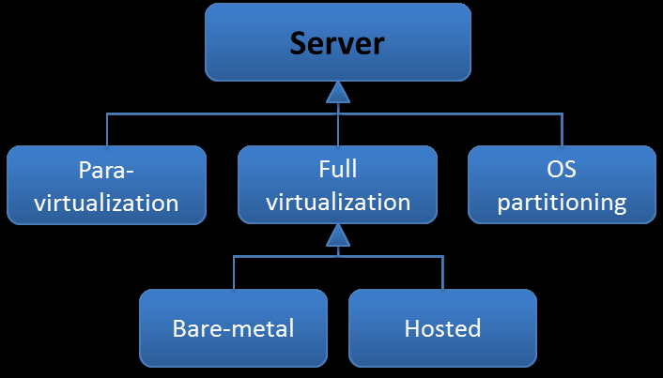
1. Server Virtualization
Server virtualization can be divided in 3 types or sub classes: Para-virtualization, full virtualization and OS partitioning.
Full virtualization technologies can be divided into two more sub classes: “Type 1” and “Type 2” hypervisors

Slide 30
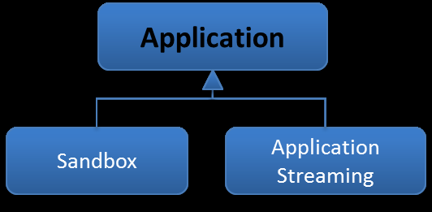
2. Application Virtualization
Two types of application virtualization technologies: sandbox and application streaming.

Slide 31
3. Desktop Virtualization
Describes two general types of desktop virtualization:
client and server.
Client desktop virtualization technologies are used to host virtual desktops (or virtual machines) locally on the clients’ computer.
Server desktop virtualization -two types: personal & shared.
Shared desktops -shared among users
Personal desktops -users having their own completely isolated desktop.
Personal desktops can further be divided into virtual or physical.
Physical desktops are equipped with additional graphic processing power for graphic intensive applications.

Slide 32
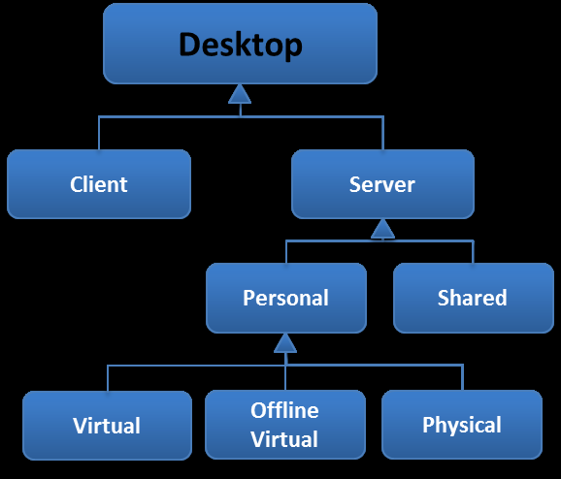
3. Desktop Virtualization

Slide 33
4. Storage Virtualization
Storage virtualization -pooling of data from multiple storage devices.
Examples of storage devices are storage attached network (SAN) and network attached storage (NAS).
While storage virtualization can be used in different or a combination of storage devices, storage virtualization can be broken up into two general classes: block virtualization and file virtualization.

Slide 34
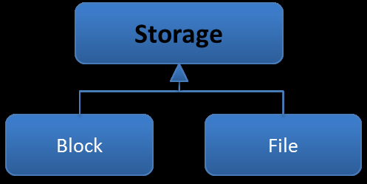
4. Storage Virtualization

Slide 35
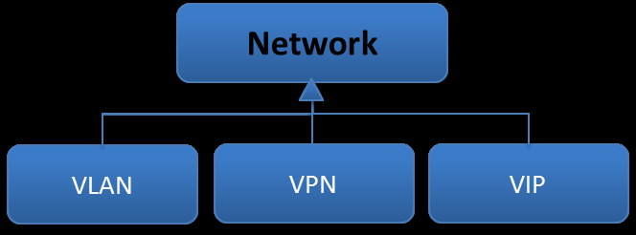
5. Network Virtualization
Network virtualization was characterized by three types of technologies:
Virtual LAN (VLAN),
Virtual IP (VIP) and
Virtual Private Network (VPN).

Slide 36
Management
The class “management” consists of a set of technologies, which can be used for management purposes.
However, management technologies for virtualization are still young and immature technologies.
In the near future more and management technologies with more features are expected.
There are currently five types of management technologies for virtualization:
Performance, Configuration, Asset, Capacity, and Cost-control.

Slide 37
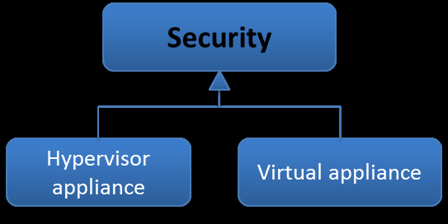
Security
Security technologies are developed specifically for virtualization.
There are two types of security tools for virtualization: virtual security appliances and hypervisor appliance.

Slide 38
Summary
The taxonomy model that is constructed above, presents an overview of all the different types of virtualization technologies.
The taxonomy model can be used for different purposes.
First of all it can be used to show what kind of virtualization technologies exist.
Secondly, the taxonomy model can be used to point out trends and in which domains new types of technologies are expected.
However, the management and security classes encompass only a set of virtualization technologies and must not be confused with other aspects of management and security, such as the making of policies and their execution.

Slide 39
Revised Taxonomy Model of Virtualization Domains
The taxonomy model lacked to illustrate the relations and dependencies between the main virtualization domains.
Also, not all virtualization domains were present in the taxonomy model.
It is better to have a layered model approach, the dependencies between the virtualization domains can be made visible.
Therefore, a revision of the taxonomy model is presented in this chapter that aims to structure the virtualization domains in a correct way.

Slide 40
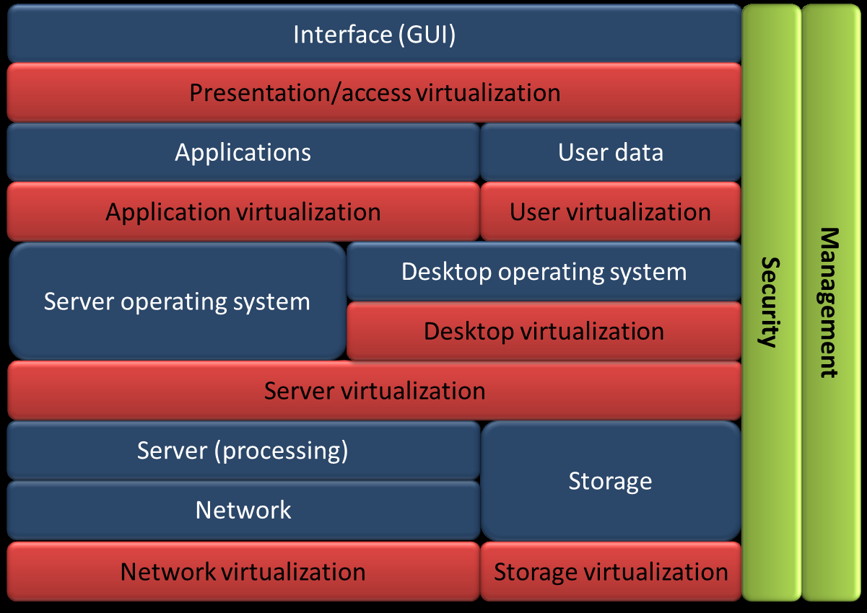
Revised Taxonomy Model

Slide 41
The blue layers
The blue layers indicate the hardware and software layers that are present in a typical server environment.
Network layer -concerned with the network requests of the upper layers and facilitates the communication from server to server or storage device, which can be located on the same private network or on a public network, such as the Internet.
It is responsible for controlling the network operations imposed by the server and operating system in the upper layers by delivering or transferring data from source to destination.

Slide 42
The blue layers
Storage layer -concerned with the storage and retrieval of data.
The storage layer is put next to the server (processing) layer as well as the network layer, because storage can be a storage device attached to the server via a network (SAN and NAS) or local storage directly attached to the server.
Server (processing) layer -concerned with carrying out the instructions of operating system layer above.
The server consists of hardware components that process the instructions imposed by the upper layers, such as a Central Processing Unit (CPU), memory, or a Network Interface Card (NIC).

Slide 43
The blue layers
Server and desktop operating system layer act as intermediaries with applications and computer hardware.
It is a software platform that manages the applications of the upper layer and handles the request of the computer programs or applications.
Regulates the ways applications communicate with computer hardware and the way users interact with the other layers in the model.
However, in a traditional server environment without virtualization, a server operates one type of operating system (OS) or instance at a time.

Slide 44
The blue layers
With virtualization, which will be explained in the red layers below, multiple instances or operating systems with their own applications can operate at the same time.
Each instance is called a virtual machine.
This way, it is also possible to host multiple virtual machines with pre-configured desktops, next to other virtual machines that host a web server or database.
These virtual machines are called virtual desktops.
Therefore, in a virtual environment multiple (desktop or server) operating systems can exist next to each another.

Slide 45
The blue layers
Application layer -concerned with requests and tasks imposed by the interface layer above.
The applications in the layer are designed to perform an activity or set of tasks that can be performed when a request or action is made in the interface layer above.
User data layer - concerned with the actions and changes made in the application layer.

Slide 46
The blue layers
In a desktop environment, users can performs tasks such as installing new applications, making or editing of documents, changing settings to their preference, etc.
These tasks produce new personal data, which are called user data.
Interface layer is the point of interaction between a user and the lower layers.
The Graphical User Interface (GUI) allows people to interact with computer programs in the layers below by offering graphical icons and elements which can be controlled.

Slide 47
The red layers
The red layers in the taxonomy illustrate the levels and layers in which the main virtualization domains relate to each other.
On the bottom, network virtualization and storage virtualization can be applied in the network layer and the storage layer.
For network and storage virtualization technologies it is not a prerequisite to have server virtualization or other types of virtualization technologies.
Server virtualization takes place above the server (processing) and storage layer and beneath the operating system layer.
This layer is also called the virtualization layer, which enables the creation of multiple isolated instances called virtual machines.

Slide 48
The red layers
Each virtual machine is equipped with their own OS and application(s), which means that multiple operating systems can operate at the same time.
Server virtualization comes also equipped with network and storage virtualization technologies.
Furthermore, with server virtualization it is also possible to create virtual desktops, which is another term for a virtual machine intended for desktop purposes.
In the same manner as virtual machines, multiple virtual desktops can be placed on a server, which means that multiple desktop operating systems can be placed on top of the server virtualization layer.

Slide 49
The red layers
Desktop virtualization is placed directly on top of the server virtualization layer.
A virtual desktop is a virtual machine.
Depending on the type of desktop virtualization technology, virtual desktops can be made for each user or a (shared) virtual desktop for a group of users.
Application virtualization takes place above the operating system layer and allows for the decoupling of the applications layer from the operating system layer.
This way, applications can be isolated from the OS and can be executed without installation on the OS.

Slide 50
The red layers
Application virtualization technologies have been used without other virtualization domains, such as server virtualization and desktop virtualization.
However, full application virtualization requires presence of a virtualization layer or server virtualization.
Full application virtualization means using the full palette of application virtualization technologies, where applications are streamed or executed from a central location.
This way, applications can be updated or changed from one point in a central location.

Slide 51
The red layers
User virtualization, also known as user state or profile virtualization creates an abstraction layer between user data by separating user data, such as profile settings, user application data and storage data from OS and application.
The user data is now stored separately from the application or OS and not interwoven.
Presentation or also called access virtualization creates an abstraction layer between user interface and the other layers below, which allows to user to access and control the other layers remotely.
The General User Interface (GUI) is streamed towards the device. User virtualization and presentation or access virtualization are both virtualization domains that in particular are used in combination with desktop virtualization.

Slide 52
The green layers
The green layers show the relation between the management and security domain with the other main virtualization domains.
Both management and security tools are also seen as types of virtualization technologies, because with virtualization new security and management issues have been addressed.
This has led to the development of new management and security tools for virtual environments.
Management and security tools have a relation with each of the other layers and have a supporting function.
For each particular layer, management and security tools can be used to provide management or security measures.

Slide 53
THANK YOU

